Slide 1

Lecture 17
Chemical Engineering for Micro/Nano Fabrication

Slide 2
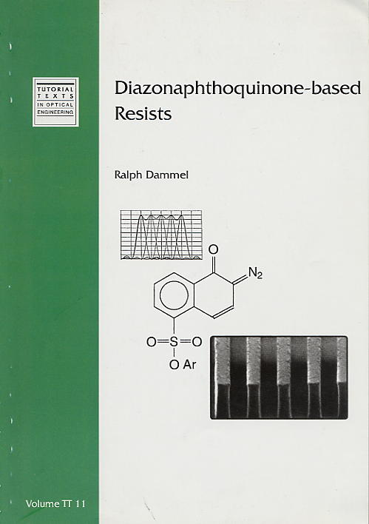

Slide 3
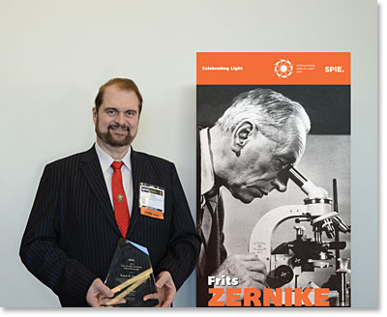
Ralph Dammel Wins Zernike Award

Slide 4
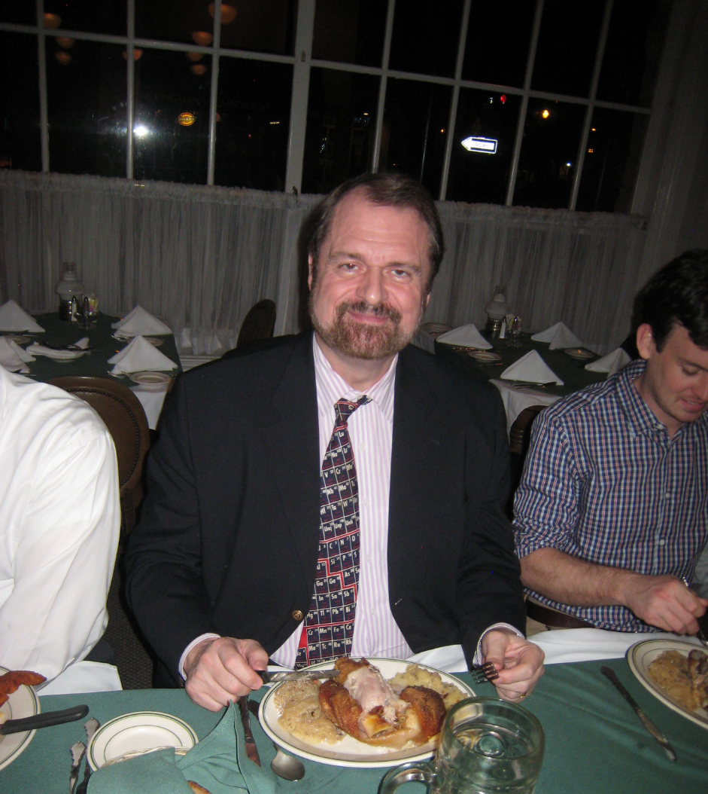
Ralph Dammel

Slide 5
Novolac/DNQ Photoresists
I
I
I
I
I
I
I
I
I
I
I
I
Coat
UV
Substrate
UV
Inhibited Novolac (I)
Photoproduct (P)
I
I
P
P
P
I
I
P
I
I
P
P
P
I
I
Expose
Novolac
Substrate
LogR
I
I
I
I
365-nm exposure
I
I
I
I
Develop
Add DNQ
Substrate
I
Notes:
The first example -- Diazonaphthoquinone/Novolac chemistry.
These photoresists operate by taking the base soluble polymer, novolac and adding a small amount of a photoactive dissolution inhibitor, diazonaphthoquinone.
Adding the DNQ causes the dissolution rate of the resist to decrease by several orders of magnitude.
The DNQ acts as the photochemically solubility switch, such that upon exposure to 365 nm light, it’s converted to a carboxylic acid.
And this exposed resist has a higher dissolution rate than the novolac alone.
The result of this change in dissolution rate is a resist image with a nearly vertical sidewall profile.
Looking at this, you’d think that the perfect resist already exists .. And it does ... Unless you want to decrease the size of the image.

Slide 6
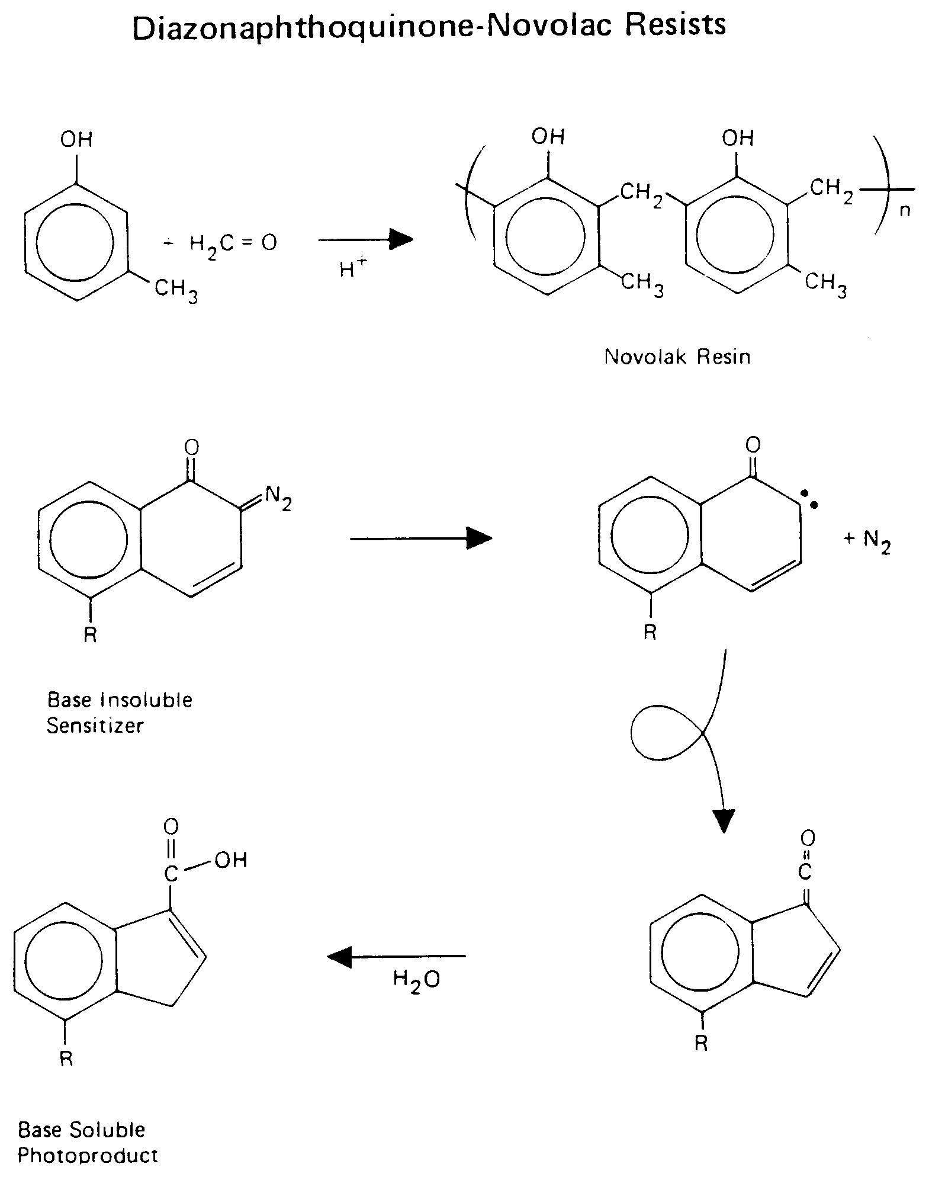
DNQ – Novolac Resists

Slide 7
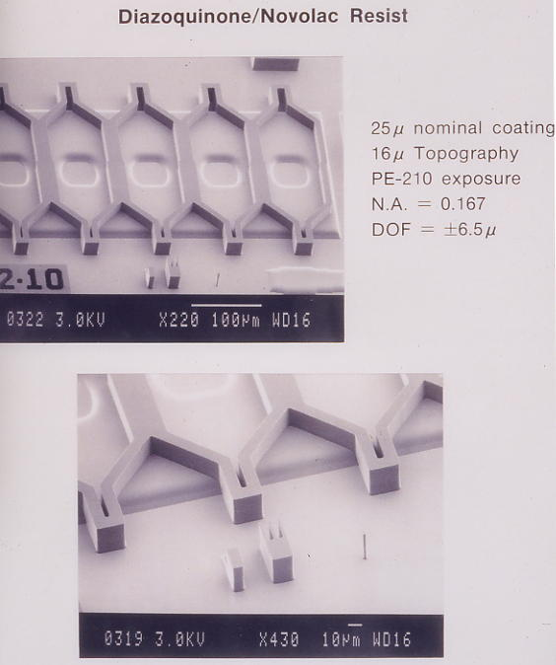
I
No Swelling!!!!

Slide 8
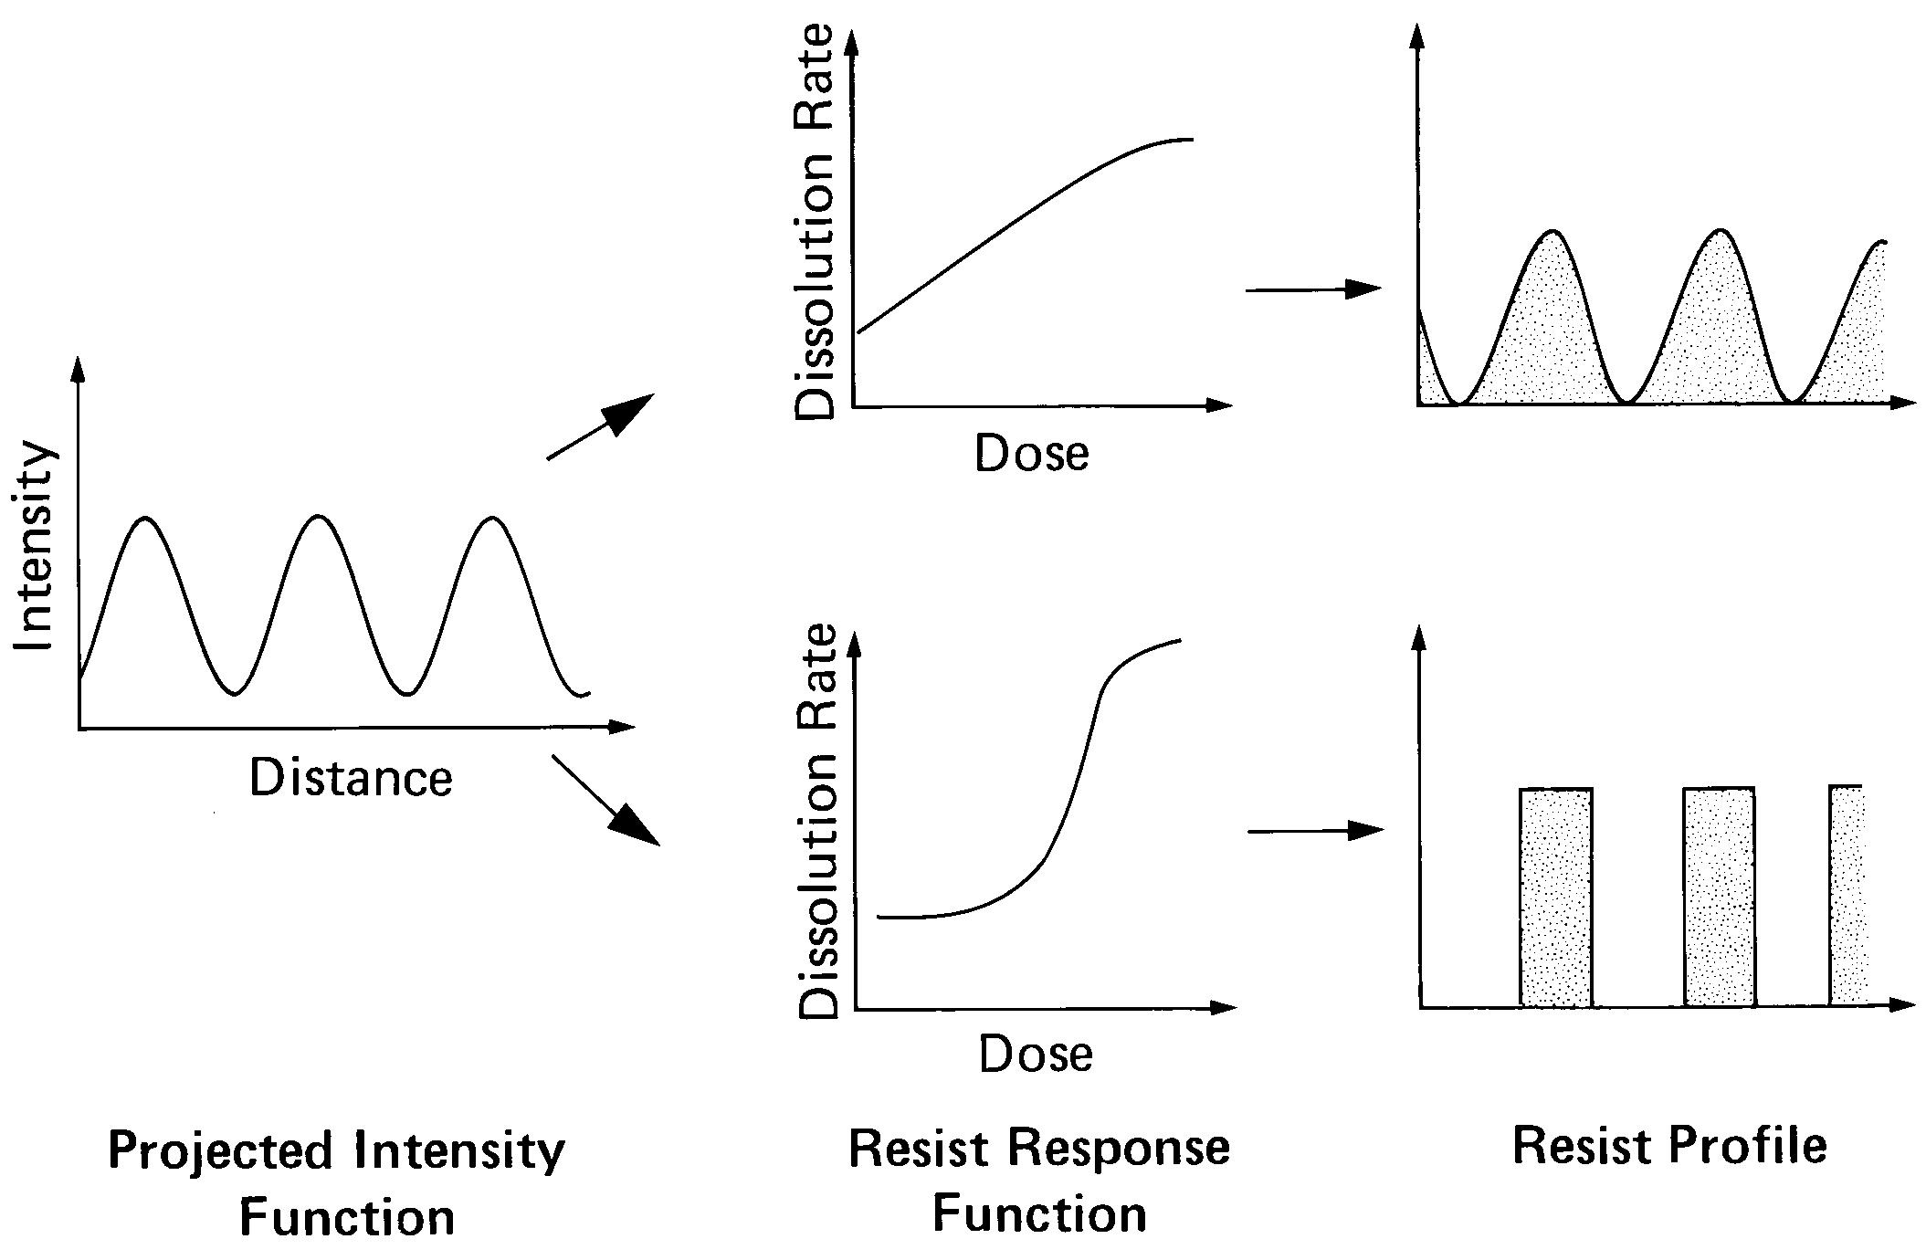
Need for non-linear dose response

Slide 9
Polyphotolysis
I → S
I-I → S-I → S-S
I-I-I → S-I-I → S-S-I → S-S-S
This contributes to a threshold like dissolution rate response to exposure

Slide 10
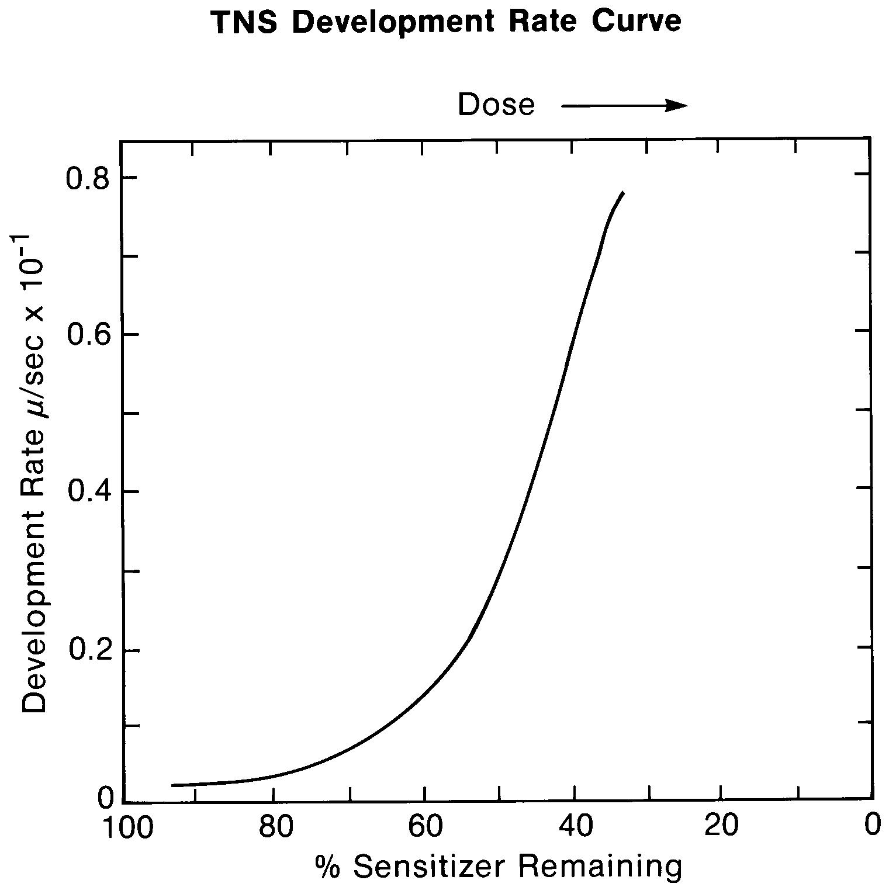

Slide 11
Threshold like Response of ArF Resist
E₀

Slide 12
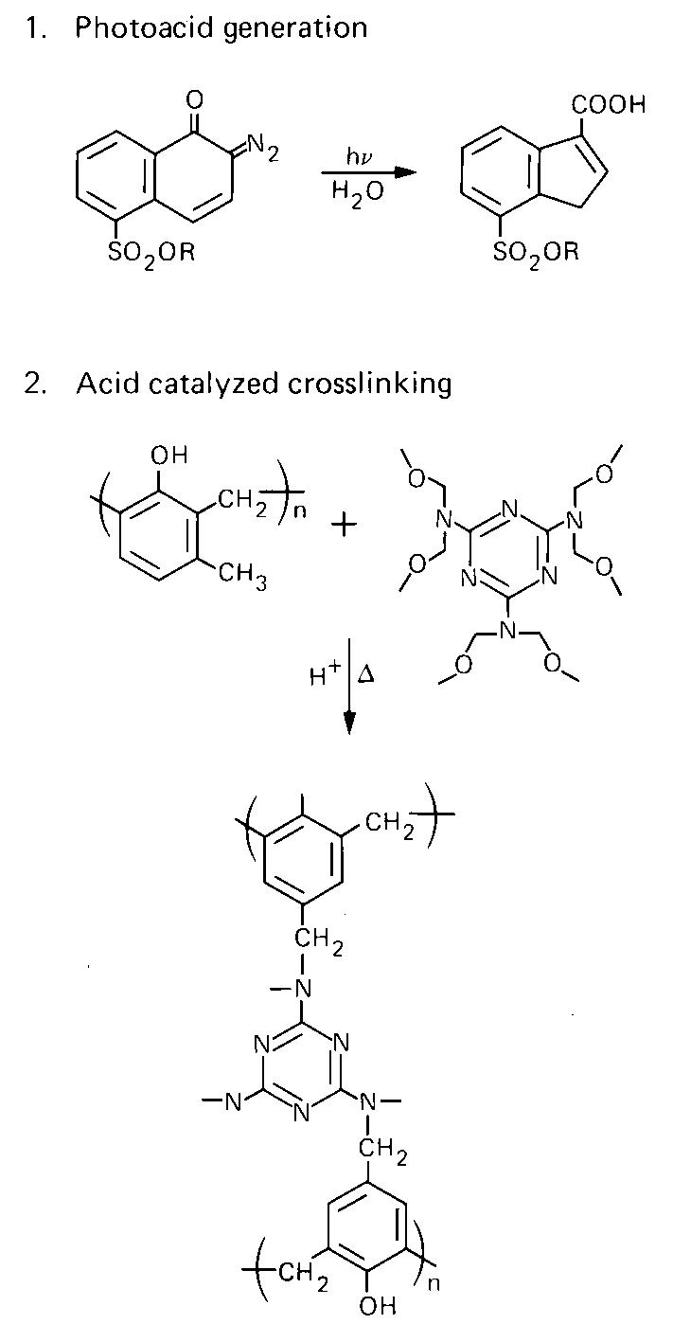
Negative Resist
Wayne Feeley
Rohm and Haas

Slide 13


Melamine Resin - Formica

Slide 14
The 2008 Chinese milk scandal was a food safety incident in China. The scandal involved milk and infant formula along with other food materials and components being adulterated with melamine.
China reported an estimated 300,000 victims in total. Six babies died from kidney stones and other kidney damage and an estimated 54,000 babies were hospitalized. The chemical gives the appearance of higher protein content when added to milk, leading to protein deficiency in the formula. In a separate incident four years prior, watered-down milk had resulted in 12 infant deaths from malnutrition.

Slide 15
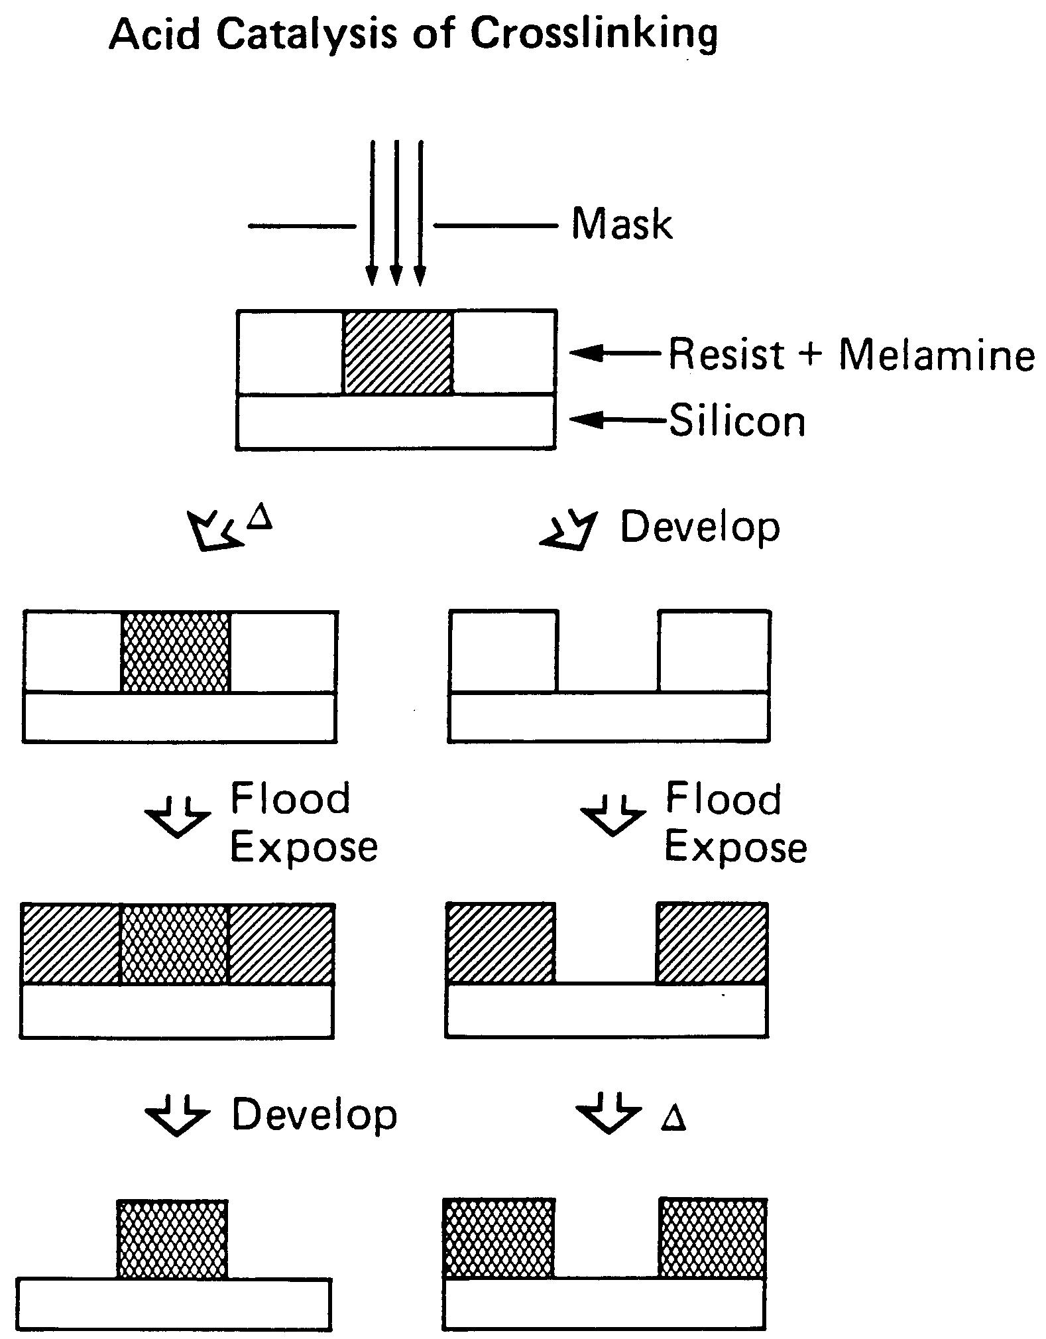

Slide 16
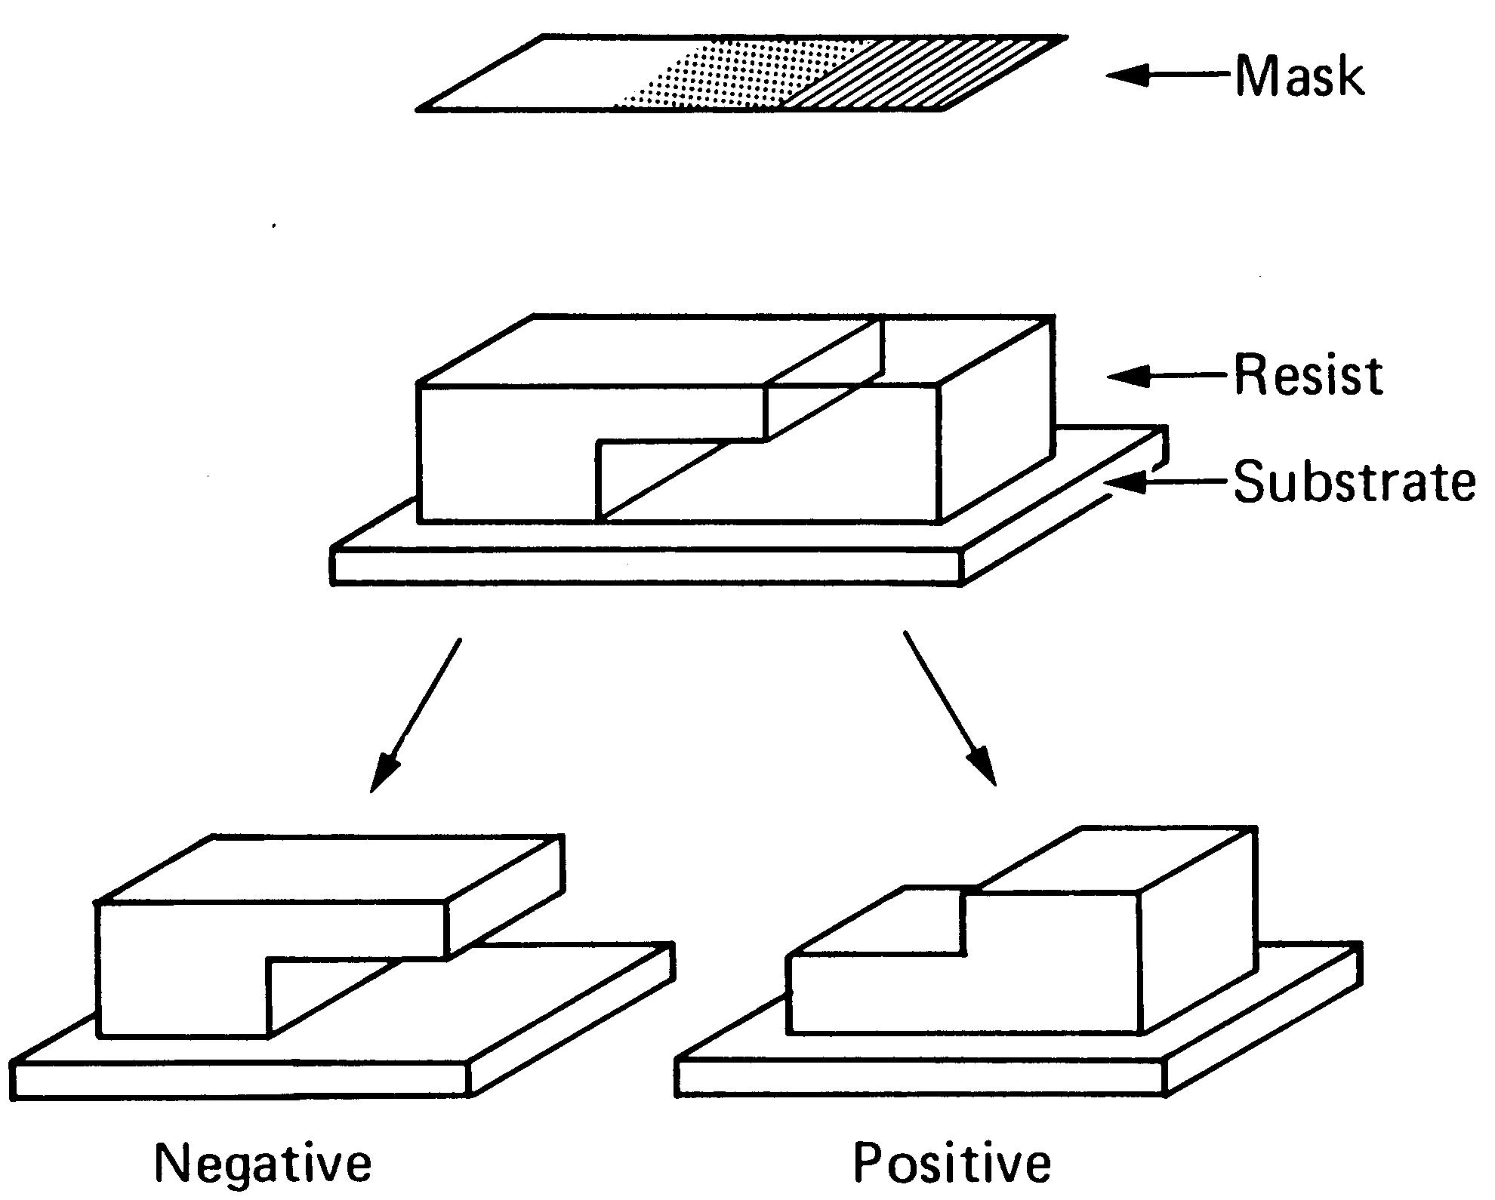

Slide 17
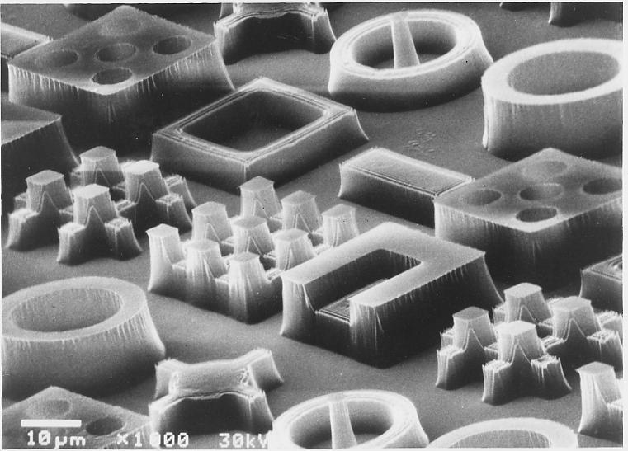

Slide 18
Quantifying Resist Performance
Sensitivity
  Intrinsic radiation sensitivity
  Lithographic Sensitivity
Contrast
Etch resistance
Adhesion
Shelf life
Etc, etc, etc.

Slide 19
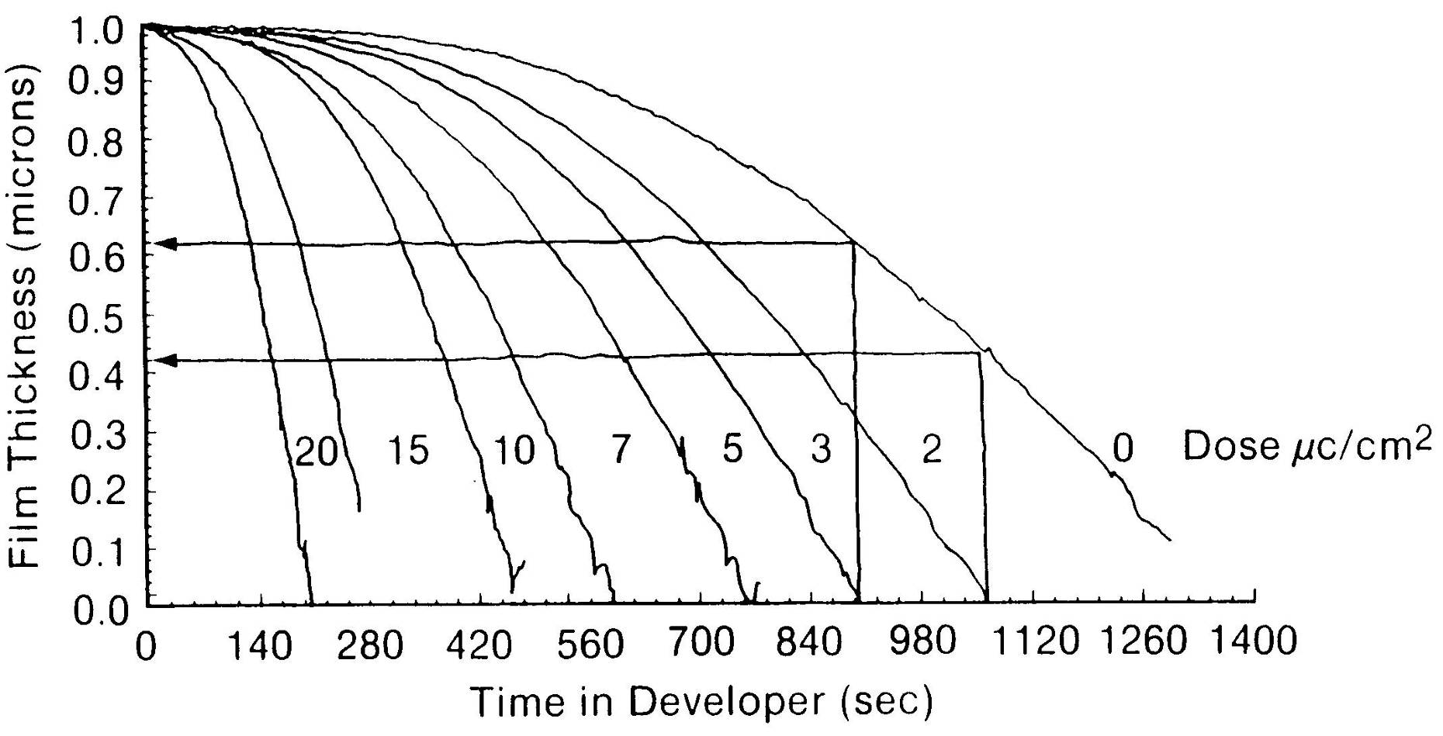
Fundamental Measure of Resist Response

Slide 20
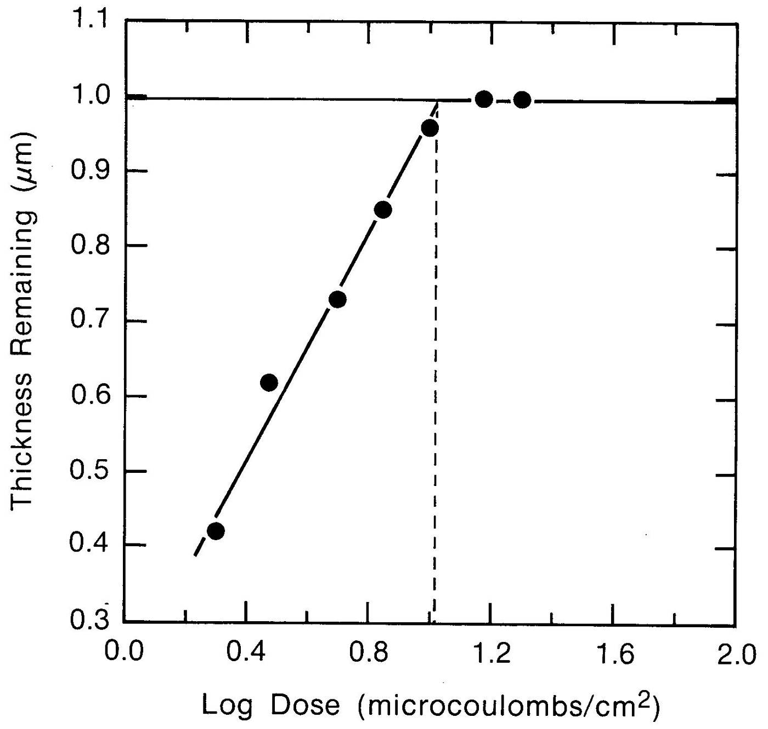

Slide 21
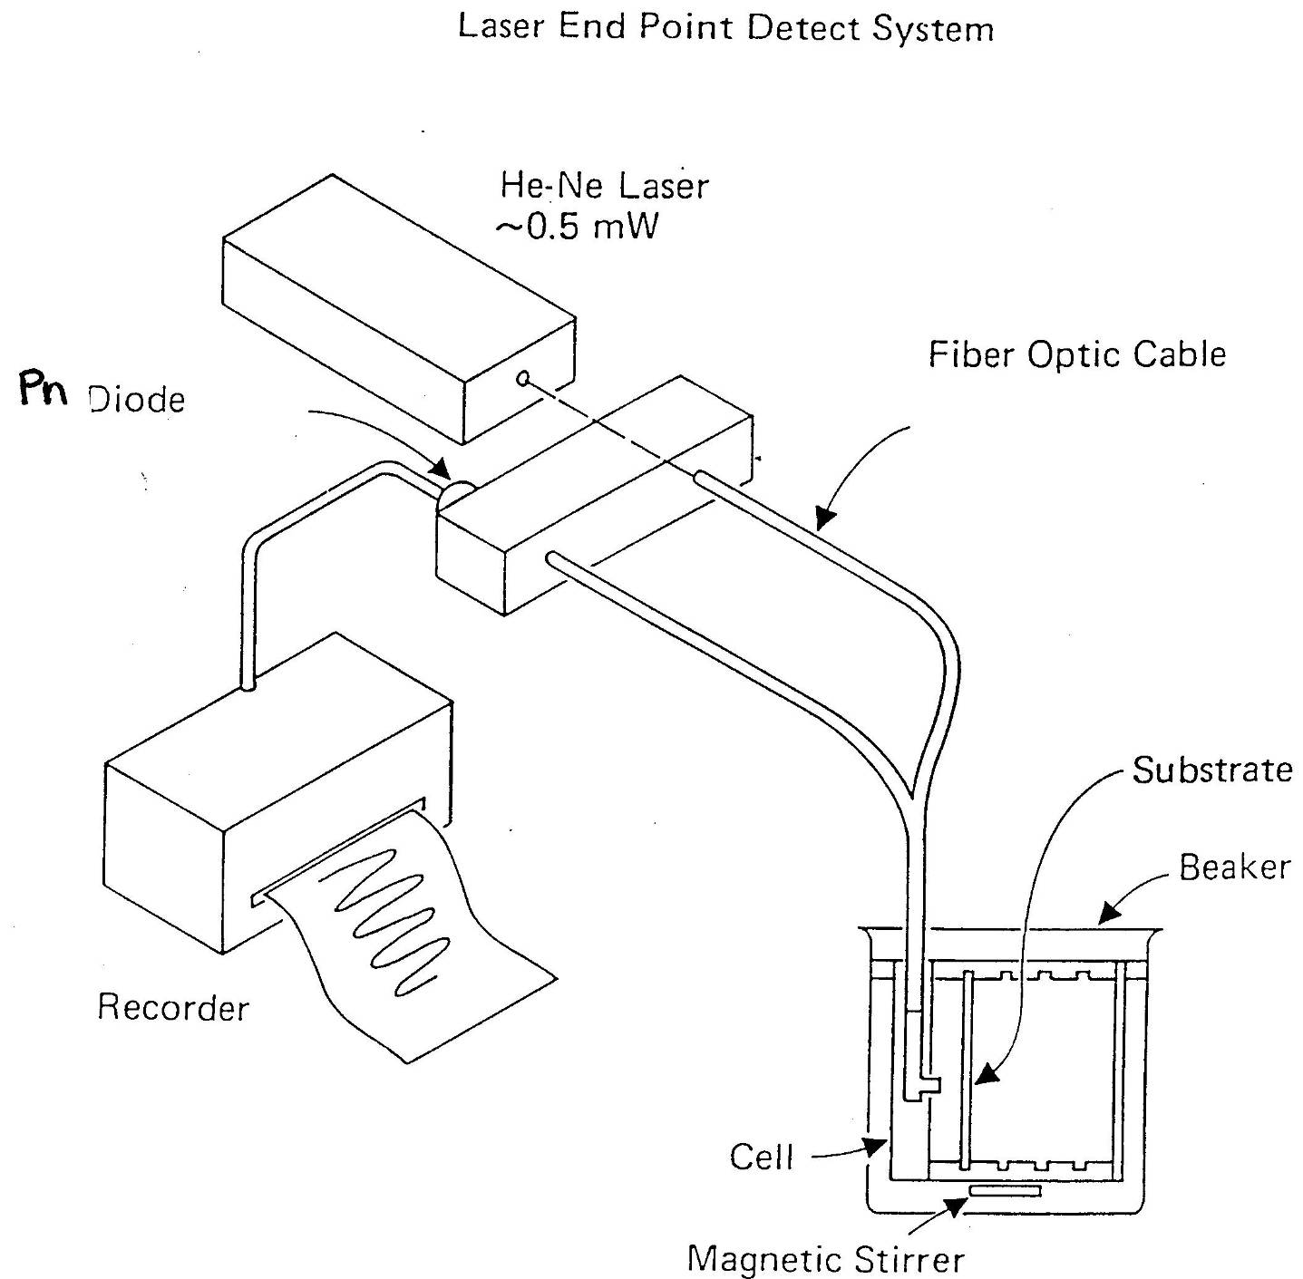
Laser end point detection system

Slide 22
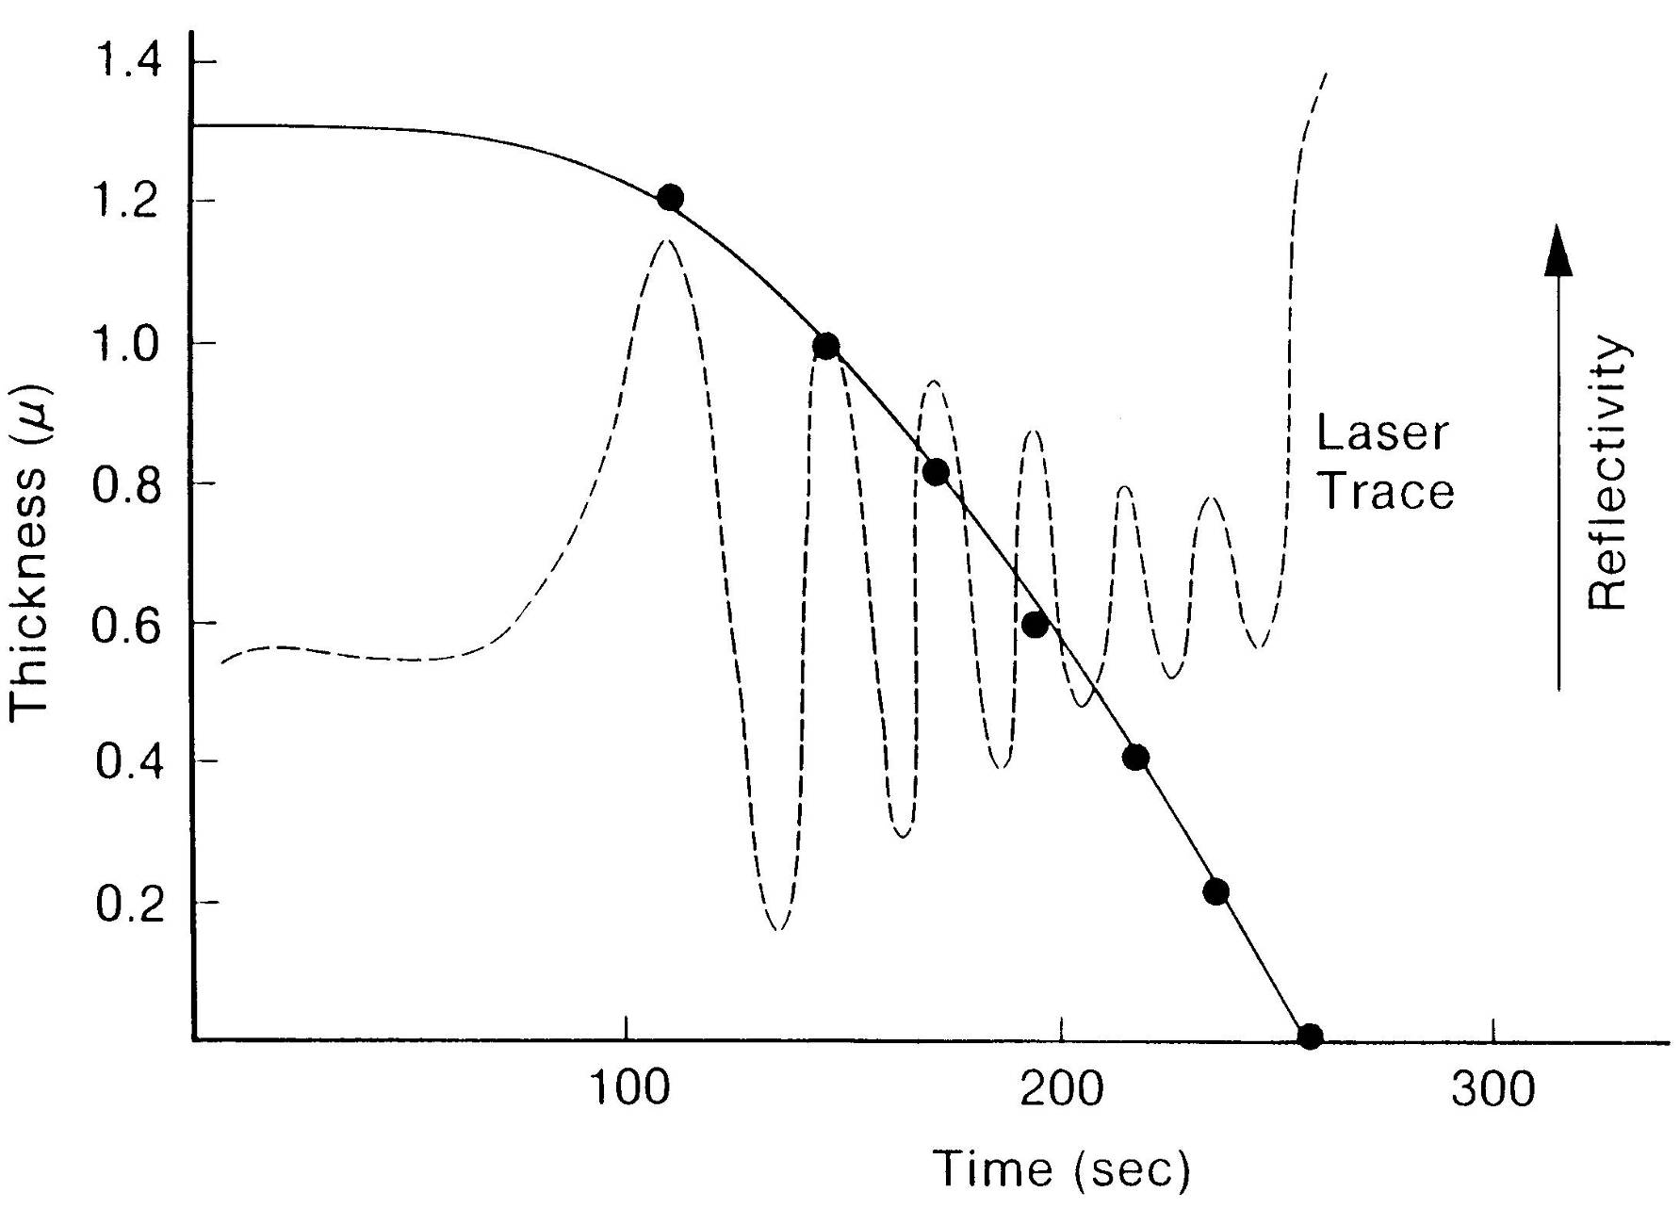
$$∆T= \frac{\text{l}}{2N}$$

Slide 23
Operates at >40Hz and measures thin films
O
Data rate > 40Hz and measures very thin films

Slide 24
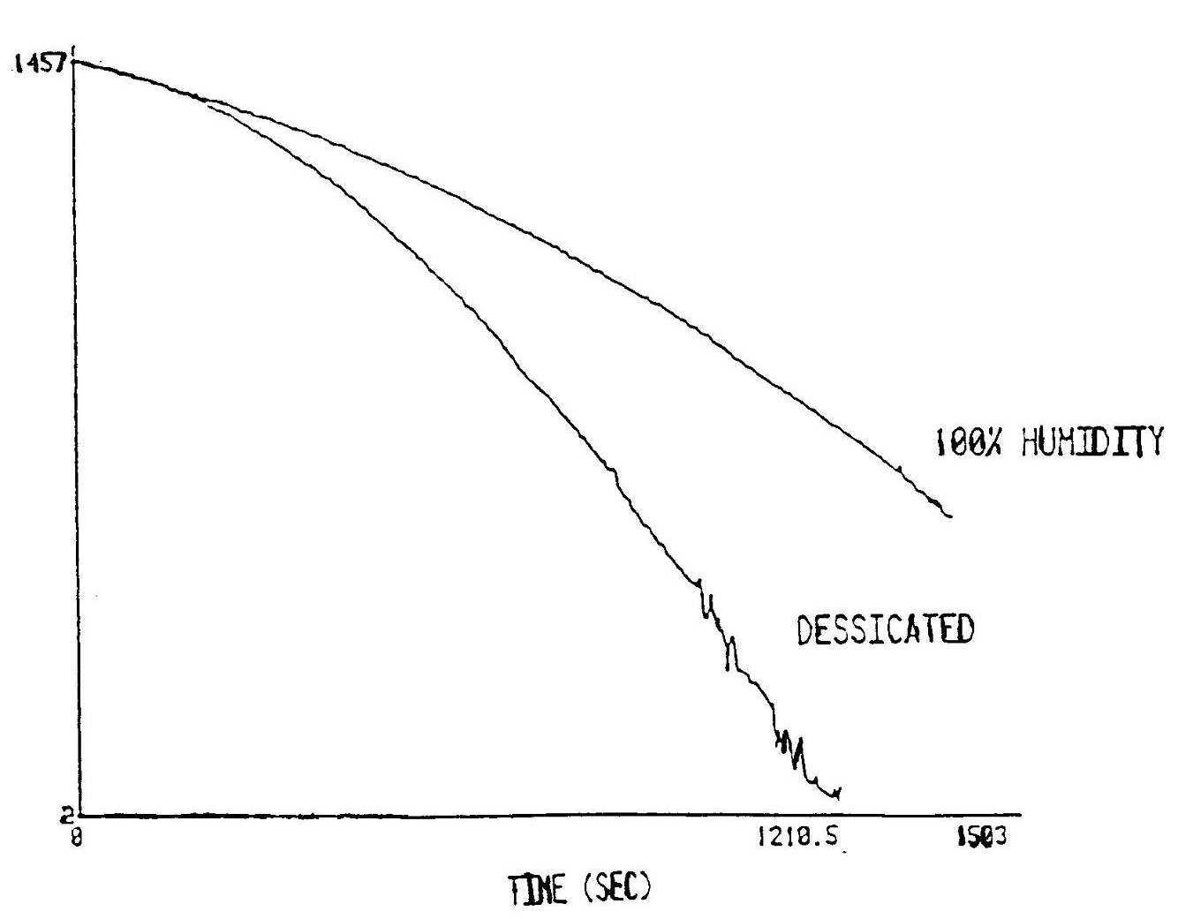
Effect of Humidity on dissolution rate

Slide 25
Dissolution Rate vs Post Apply Bake Temperature

